Slide 1
The Role of EEG in the Diagnosis and Management of Epilepsy
Stephen J. Falchek MD

Slide 2
I have no conflicts of interest to declare
Objectives:
What is an EEG?
Why do we value them?
What are the benefits and limitations?

Slide 3
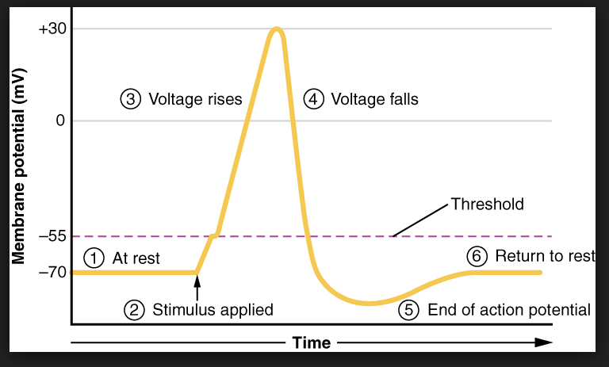
First Presumptions
Brain and muscle are electrical organs
For any effect to occur, a signal must be propagated in a meaningful way to produce an end result
The mechanism of electrical signal transmission along nerve cells is called an action potential
These are extremely low-voltage phenomena, 30-90 1/1,000,000th of a volt

Slide 4
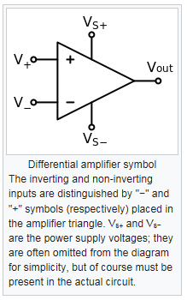
What is an Electroencephalogram (EEG)?
One of a family of objective recordings of manifestations of cerebrally generated electrical activity
A graphic demonstration of brain electrical activity as seen by an array of differential amplifiers

Slide 5
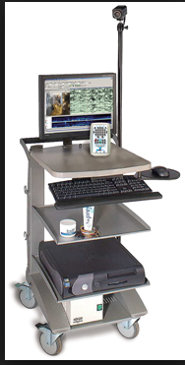
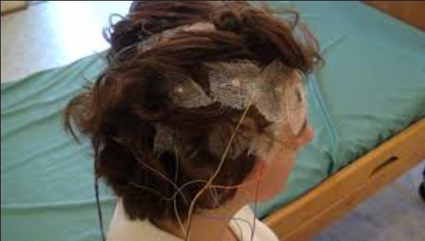

Slide 6
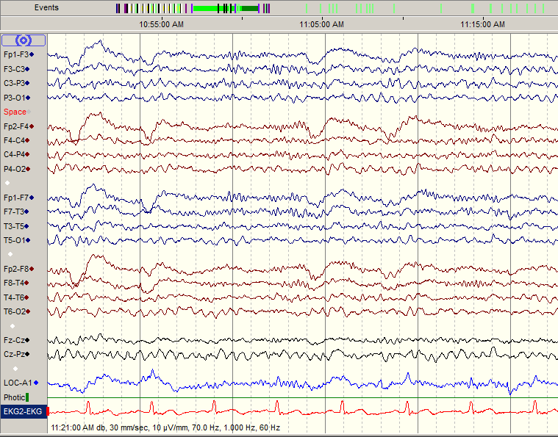

Slide 7
Scientific Evidence
Commonly used vernacular term but with many associated notions
Information that is:
Verifiable
Reproducible
Either supports or refutes an hypothesis

Slide 8
Why Do We Need Scientific Evidence in the Treatment of Persons with Epilepsy?
Epilepsy is a vast topic with many features unique to individuals
We wish to apply our collectivized knowledge base to the individuals whom we are trying to help:
Accurately
Safely
Effectively
Improve understanding of the phenomena affecting an individual

Slide 9
What do we seek when we do an EEG?
“Scientific Evidence” for:
Epilepsy/seizure activity
Nonspecific abnormal brain activity
Abnormal maturation
Efficacy of treatment
Identification of suspicious abnormal behaviors
Remission of epilepsy
A normal EEG does not preclude the diagnosis of epilepsy
But it can help to prove the nature of suspicious events, changes in mental state, and presence or absence of degenerative disorders
An abnormal EEG does not necessarily prove the diagnosis of epilepsy
But it can help to quantify the risk of having this condition
EEG abnormality in up to 25% of asymptomatic 1st degree relatives of patients with epilepsy!
An EEG is one piece of evidence in the evaluation of epilepsy
All evidence must be interpreted in its proper context!

Slide 10
What does an EEG “see”?
The potential difference(voltage difference) between two inputs (always electrodes in some location on the human body)
This is affected by:
Anatomic placement of the inputs
Scalp, face, ear, body, or brain directly
Quality of contact with the body surface
Distance from the generator of the signal in question
Movement
Presence of neurotropic medications
Quality of the electrical circuitry in the EEG machine and connections
Presence of strong oscillating electromagnetic fields in the vicinity of the recording

Slide 11
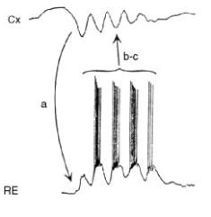
What does an EEG “see”?
EEG electrodes cannot detect individual action potentials
Regional charge separation due to the firing of many action potentials concentrated in one location
Summation of these potentials will produce an observable deflection in the EEG recording

Slide 12
Additional Considerations
Given the low voltages and general weakness of electrical fields, EEG can only see electrical phenomena occurring fairly close to the electrodes themselves
The skull, muscle, skin, and subcutaneous fat of the head act as low-pass filters [i.e. they block many fast frequencies from reaching the electrodes on scalp-surface recordings]
Good conductors will allow even low signals to be passed considerable distances
E.g. fluid collections with high electrolyte content, such as the cerebrospinal fluid, may make a distant generator of signal seem closer to the electrode
Brain is organized in highly efficient networks for conduction
This may also cause a distant generator of signal to seem closer to the recording electrode
These factors can result in either missing data or false localization

Slide 13
EEG Evolves with Maturation
We do not remain the same throughout life or even childhood
EEG is vastly different from infancy through late childhood
Begins as a discontinuous, spiky recording (earliest recordings around 24-25 weeks’ gestation)
Conceptional age is crucial in correct interpretation
No sleep/wake differentiation in prematurity
Sleep, awake, and indeterminate states by term
Evolves into a continuous recording with distinct awake and sleep states

Slide 14
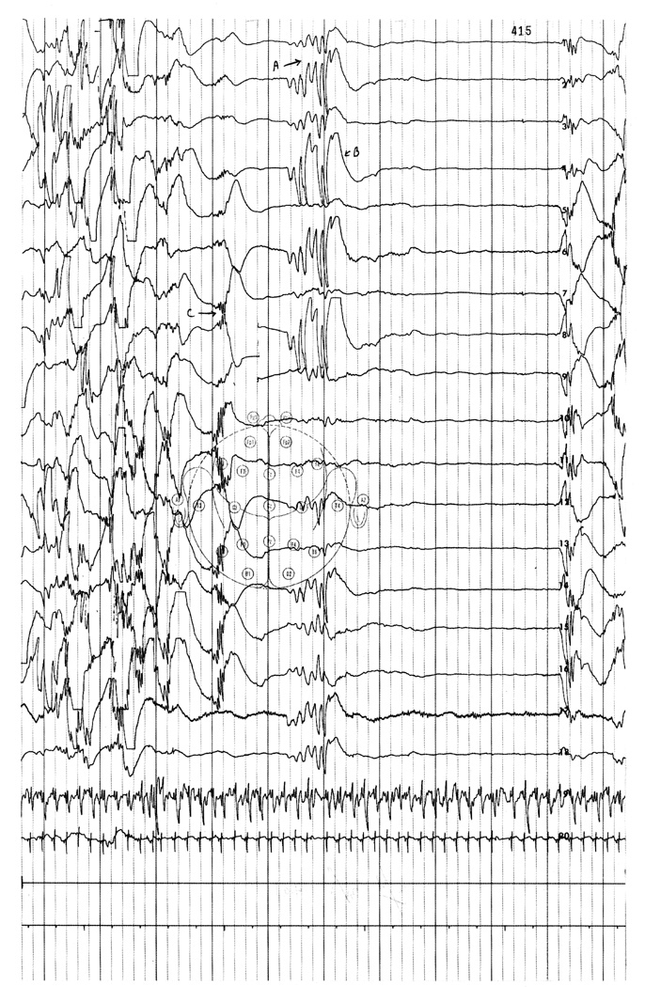
25 weeks

Slide 15
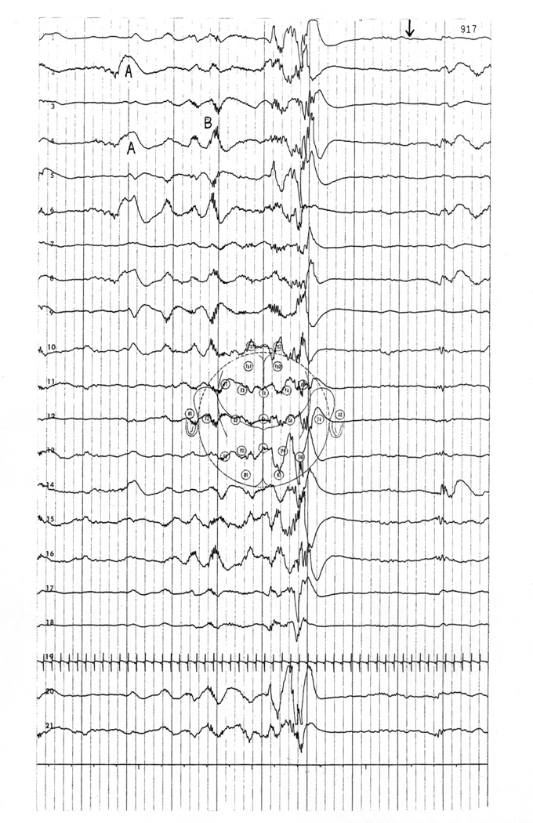
31 weeks

Slide 16
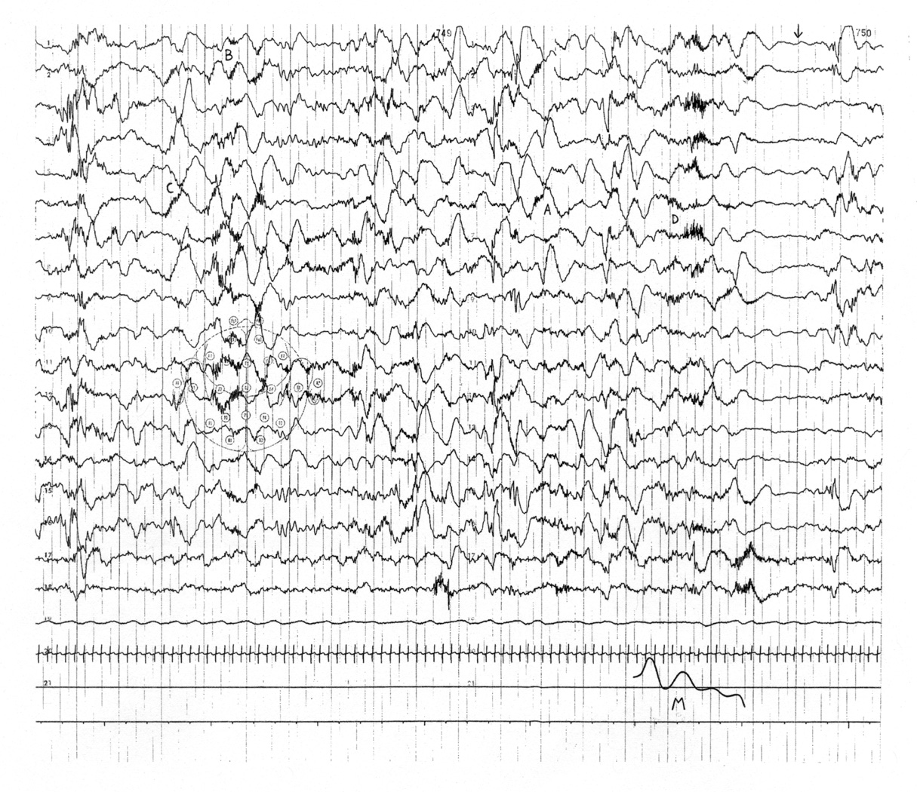
33 weeks
awake

Slide 17
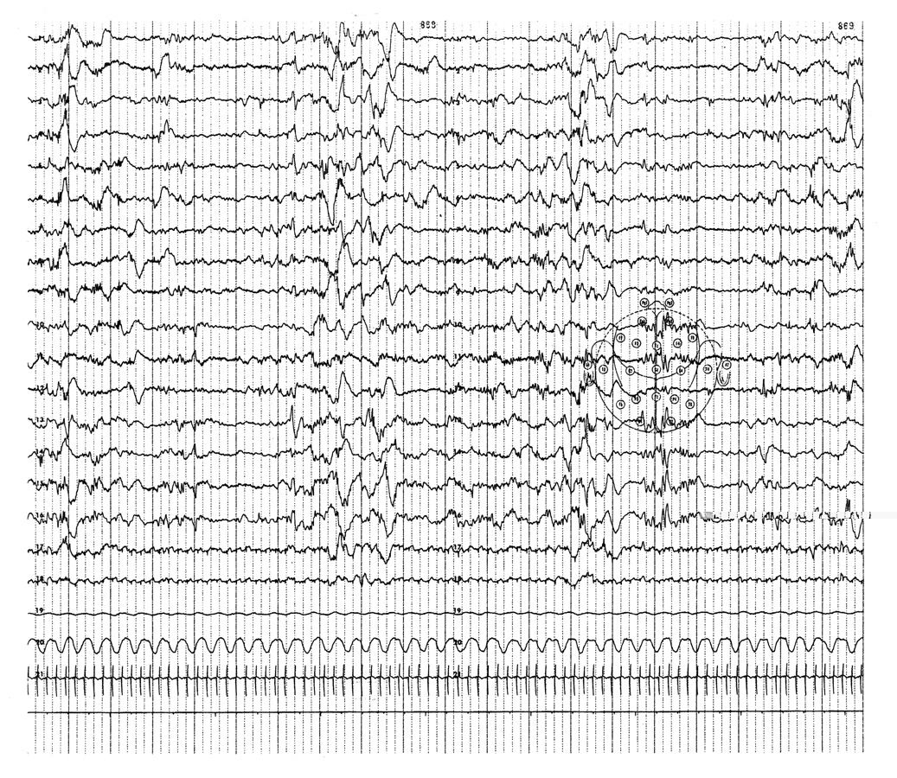
37 weeks
quiet sleep

Slide 18
2 years old

Slide 19
15 years old

Slide 20
Same patient, sleep

Slide 21
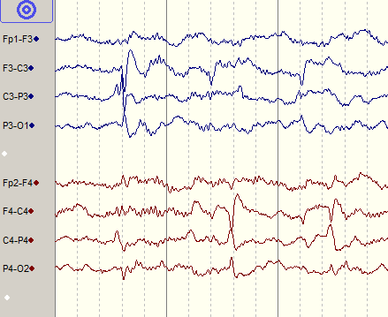
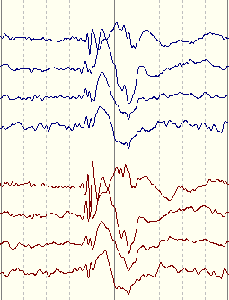
Abnormalities and EEG
The most commonly observed abnormality in the evaluation of epilepsy is the epileptiform discharge, AKA epileptiform activity
Most classic example is the spike or sharp wave
Also spike and slow wave
Focal vs. generalized

Slide 22
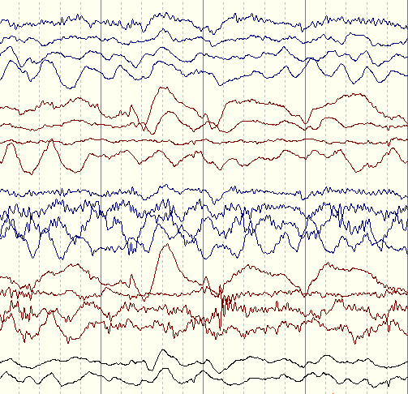
Abnormalities and EEG
Also may see slowing of background activity
Especially meaningful if focal and persistent
Sometimes may be the main indicator of a seizure occurring or having occurred recently
Importance of abrupt pattern changes
Should be distinguished from background slowing which may be a developmental/maturational hallmark, or an isolated and possibly irrelevant finding

Slide 23
Abnormalities and EEG
Seizures and suspicious events can be definitively captured on EEG
Useful in identifying seizure type
Identifying best medication options
Qualifying individuals for epilepsy surgery
Differentiating between seizures and non-epileptic phenomena
Likelihood of seizure capture depends upon:
Frequency of events
Susceptibility to triggers, i.e. “reflex epilepsies”
Duration of the EEG monitoring session
The desire to capture and identify real-time events is the principal indication for prolonged video EEG monitoring

Slide 24
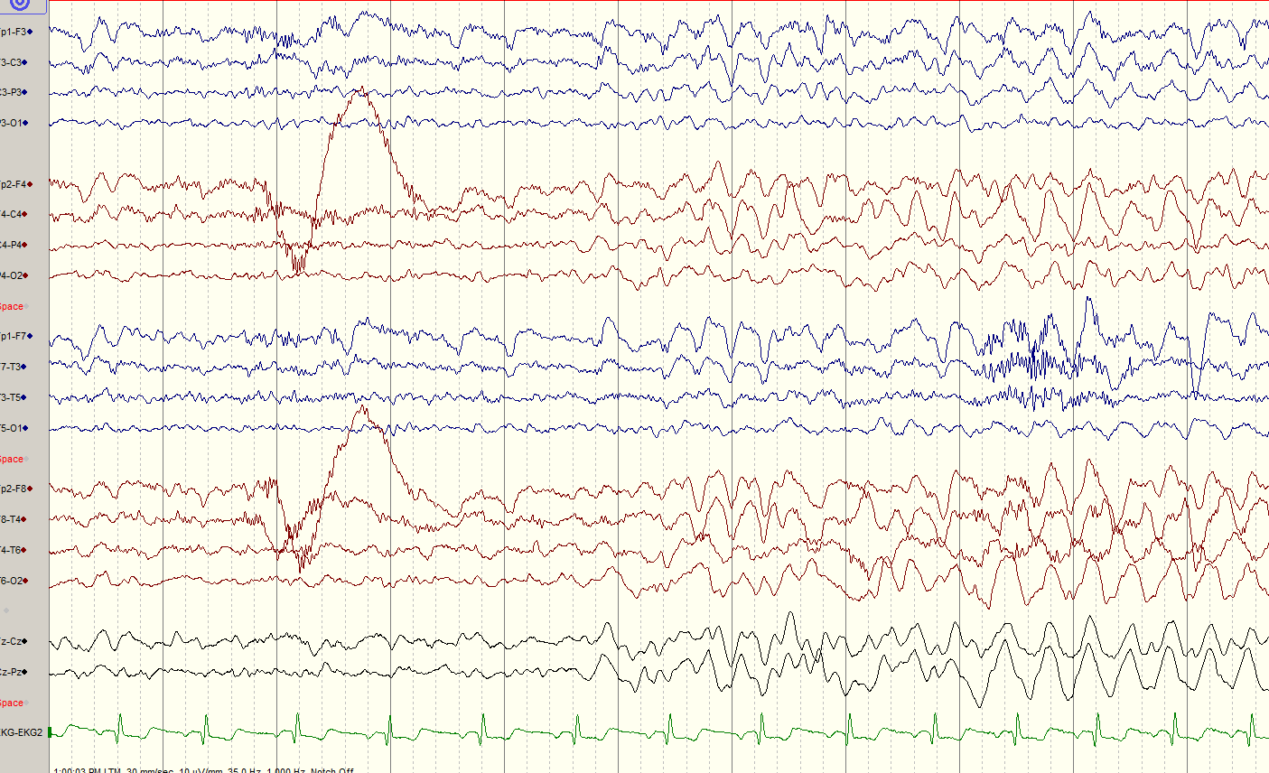

Slide 25
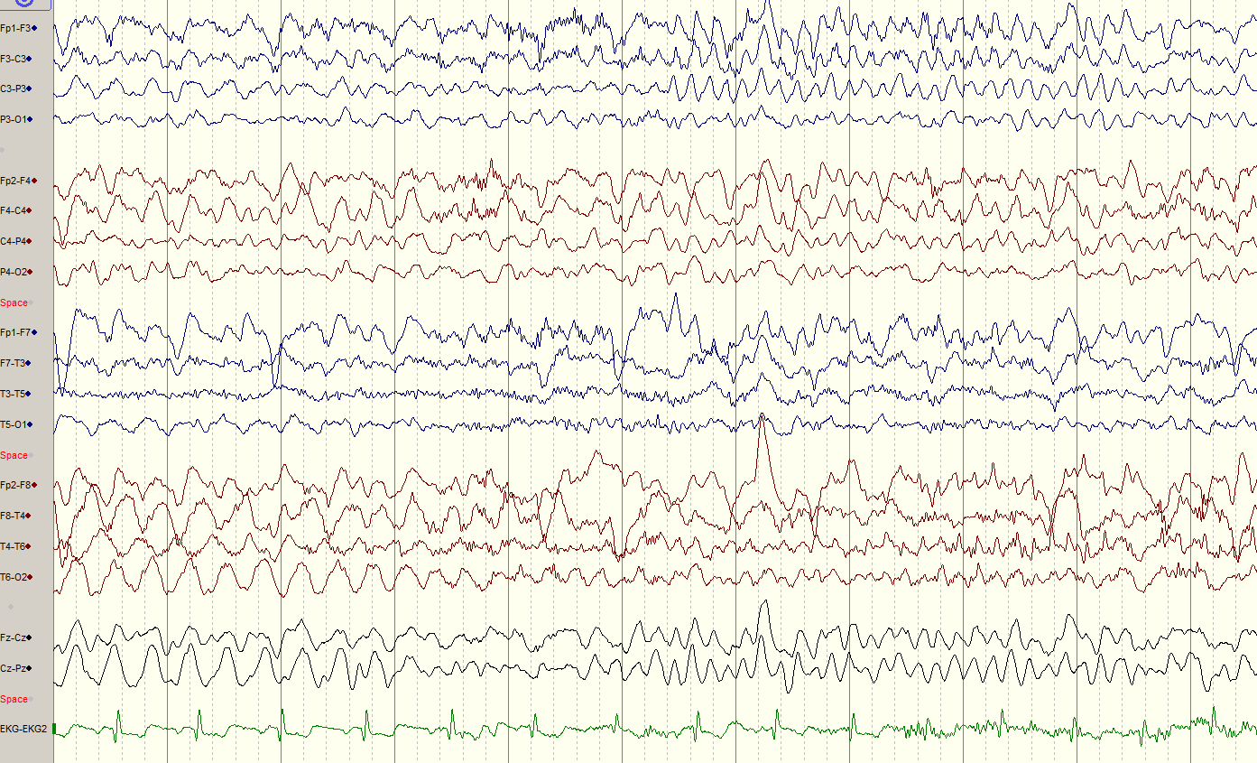

Slide 26
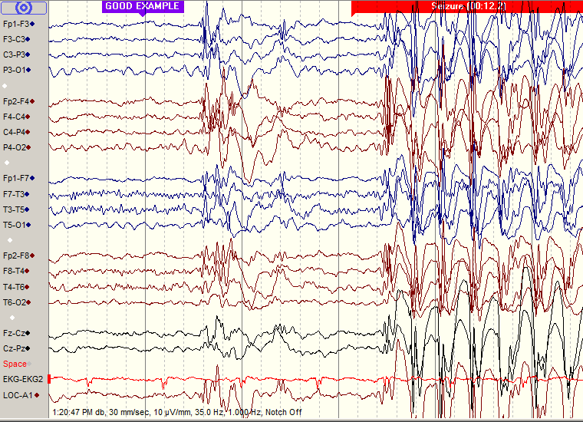

Slide 27
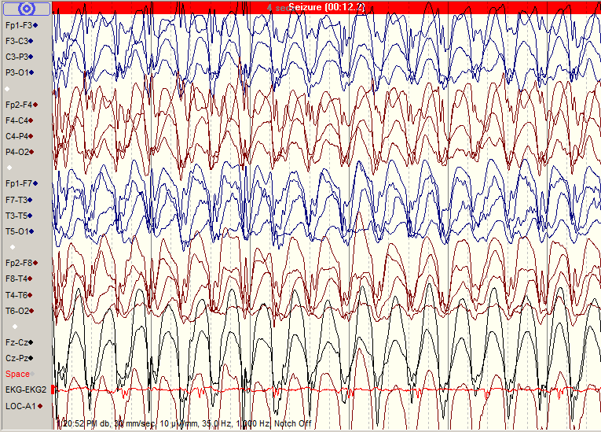

Slide 28
7 year old boy, awake

Slide 29
Same 7 year old boy, asleep

Slide 30
Prolonged EEG monitoring
Useful when:
Events need to be seen to identify their nature
If not feasible by routine 30-45 minute EEG session
Searching for location of seizures
Suspect occult [“hidden”] seizure or seizure-like activity, e.g.:
Electrographic status epilepticus of slow wave sleep (ESES)
Nocturnal seizures
To determine “spike burden” in cases thought to have an “epileptic encephalopathy”
It is not necessary to capture seizures on EEG to give a diagnosis of epilepsy
However capturing events can help to eliminate ambiguity as to their nature or treatment options
A completely normal EEG during a recorded event generally rules out epilepsy, and is one of the few useful applications of a normal EEG

Slide 31
Prolonged EEG monitoring
Inpatient video-assisted monitoring
The “gold standard” of monitoring
Essential in the first steps of an epilepsy surgery evaluation
May require multiple days of monitoring
Cannot leave room, time off camera must be limited, e.g. bathroom breaks
Patient must be visible at all times
Blankets!
Visitors/staff standing in front of the camera!
Parent/guardian must be present at all times
Especially someone who can identify the episodes in question
May attempt activation e.g. sleep deprivation, withdrawal of anticonvulsant medication, strobe, light bedside exercise, reading, etc.
Other special triggers are limited

Slide 32
Prolonged EEG monitoring
Ambulatory EEG monitoring
At-home portable wearable recording device
Relatively frequent events
First stages of determination of diagnosis of epilepsy
To assess efficacy of a treatment strategy in individuals with frequent, easily detected seizures
To identify nature of events seen only under specific circumstances at home, which might represent a rare “reflex epilepsy”
NOT suitable for epilepsy surgery evaluations
Data need to be downloaded every 24 hours
Not suitable for very prolonged monitoring periods
No technical support when at home

Slide 33
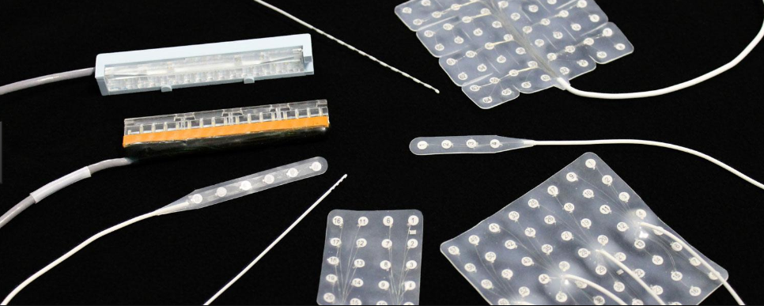
Further EEG monitoring
Electrocorticography
Electrodes imbedded in a plastic sheet are placed on the surface of the brain
“grids”
“strips”
“Depth electrodes” arranged along a needle are inserted into the brain

Slide 34
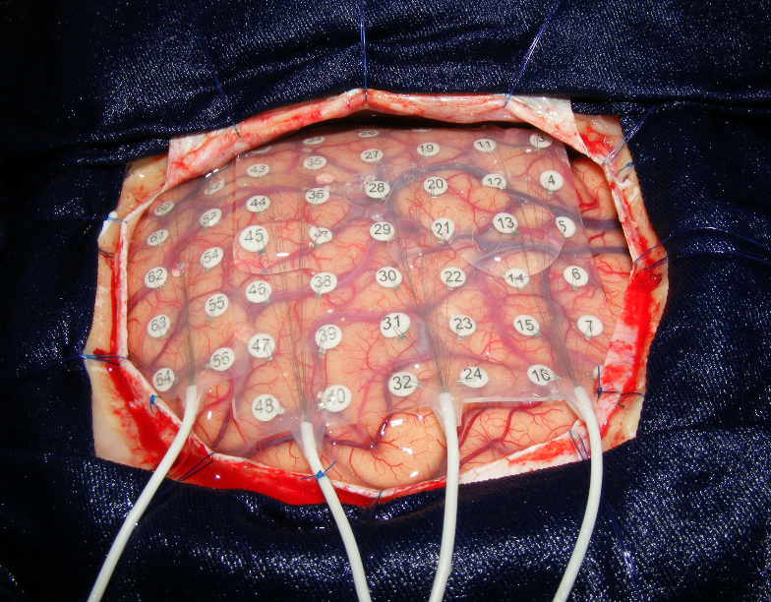

Slide 35
Electrocorticography

Slide 36
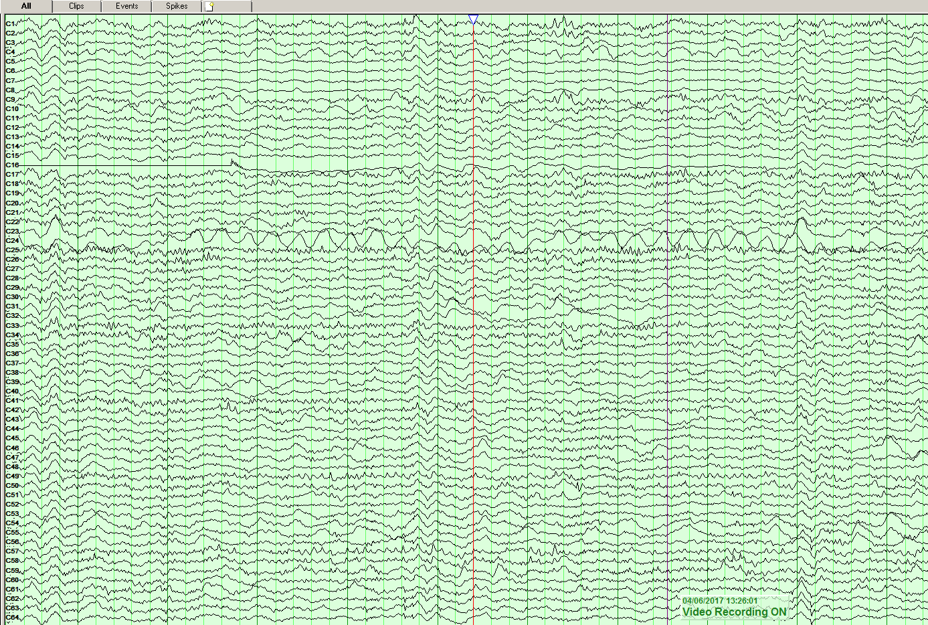

Slide 37
Why don’t we do EEGs on everybody? Why don’t we do prolonged EEGs on everybody?
EEG is one piece of evidence that has to be interpreted in its proper context
E.g. up to 25% of the unaffected relatives of persons with epilepsy may have an abnormal EEG
We treat individuals, not EEGs
For prolonged EEG to be useful, the sampling interval has to be known
There is a practical cost to doing more and longer studies which must be taken into account

Slide 38
What is the Value of Follow-up EEGs?
Many anticonvulsant medications can force-normalize an EEG, but…
Normalization of EEG is not always a goal of therapy
EEG is used as a rough guideline for attempts to withdraw therapy
Presumption that if EEG does not normalize, then the epilepsy is less likely to be in remission
Normalization of EEG while on medication does not guarantee remission of epilepsy
When we do care about the “spike burden” on EEG, it is often the clinical outcome i.e. improvement in global functioning, which is the more important result

Slide 39
Future directions in EEG
“high-density” EEG
“quantitative” EEG
“stereo” EEG

Slide 40
Conclusions
EEG is a useful tool for:
Diagnosis
Treatment options
Treatment efficacy
Localization for epilepsy surgery
EEG can be misleading if:
It is seen as an end unto itself and not a part of a larger picture
Its limitations are not understood

